Slide 1
Before you begin…
This slide deck is built from the 2018 ILST Facilitator Guide.
The slides provide a good reference, but we strongly encourage you to not run the course as a slide-based lecture.
Review the ILST Facilitator Guide and update the slides as appropriate for your troop and presentation needs.
The Positions of Responsibility slides are hidden since the intent is to use the card handouts…but we left them in as an option for everyone to clearly see all duties.
The ILST guide is meant to offer the Scoutmaster and senior patrol leader a flexible training program for troop leaders. It is not a syllabus to be followed verbatim since every troop is different. Trainers can review the resource material and adapt it to their individual troop’s needs. (ILST Facilitator Guide pg 5)

Slide 2

Troop ### - ILST
Introduction to Leadership Skills for Troops

Slide 3
ILST Schedule
< modify as appropriate for your Schedule >
Friday, DD MMM
1800-1900 Dinner <possibly a campfire if conducting on a campout>
1900-2000 Module 1
2000-2200 <insert fellowship opportunity - movie, cracker barrel, etc.>
Saturday, DD MMM
0800-0900 Breakfast & Area Clean-Up
0900-1000 Module 2
1000-1100 Module 3

Slide 4
Mission Statement
The mission of the Boy Scouts of America is to prepare young people to make ethical and moral choices over their lifetimes by instilling in them the values of the Scout Oath and Law.
“Train Scouts to do a job, then let them do it.”
“Never do anything a boy can do.”
“Training boy leaders to run their troop is the Scoutmaster's most important job.”
—Robert Baden-Powell

Slide 5
Why Conduct ILST?
Scoutmaster’s Perspective
  A Scoutmaster can’t expect the youth leaders in his troop to know what their jobs are unless they have been told.
  The concept of “Scout-led” is very dependent on the training of, and follow-on mentoring, to the Scouts.
Scout’s Perspective
  Leadership is a vital part of Scouting…be prepared for your role
  ILST is part of a leadership continuum: National Youth Leadership Training (NYLT) and National Advanced Youth Leadership Experience (NAYLE)

Slide 6
ILST Overview
Module 1 – Troop Organization
Includes a description of each leadership position in the troop, including roles and responsibilities, troop organization, and introductions to vision and servant leadership.
Module 2 - Tools of Leadership
Covers some core skill sets to help the Scout lead, including communicating, planning, and teaching.
Module 3 - Leadership and Teamwork
Incorporates additional leadership tools for the Scout, including discussions of teams and team characteristics, the stages of team development and leadership, inclusion/using your team, a more in-depth review of vision, and ethics and values of a leader.

Slide 7
Module 1
Troop Organization

Slide 8
Module 1 Overview
Introduction to the Course
Introduction to Vision
Troop Organization
The Team-Based Troop
Leadership Styles

Slide 9
Introduction to the Course
The purpose of Introduction to Leadership Skills for Troops (ILST) is to provide tools you will need for fulfilling your role as a leader in the troop.
You have been selected to be leaders in your troop. This is both an honor and a responsibility.
Good leaders are not “all about themselves.”

Slide 10
Introduction to Vision
You must first know what success looks like before you can reach that success.
BSA Vision Statement: “The Boys Scouts of America will prepare every eligible youth in America to become a responsible participating citizen and leader who is guided by the Scout Oath and Law.”
A vision is a short clear statement that describes the changes that should result from what you want to do.

Slide 11
Troop Organization
< modify as appropriate for your Troop >
Scoutmaster
ASM/Patrol Advisor
ASM/Patrol Advisor
ASM/Patrol Advisor
ASM/Patrol Advisor
Senior Patrol Leader
Asst. Senior Patrol Leader
<PATROL>
Patrol Leader
<PATROL>
Patrol Leader
<PATROL>
Patrol Leader
<PATROL>
Patrol Leader
Webmaster
<name>
Librarian
<name>
Outdoor Ethics
<name>
Chaplain’s Aide
<name>
Scribe
<name>
Instructor
<name>
Troop Guide
<name>
Quartermaster
<name>
Mentor
<name>
Mentor
<name>
Mentor
<name>
Mentor
<name>
Mentor
<name>
Mentor
<name>
Mentor
<name>
Mentor
<name>
Historian
<name>
OA Troop Rep
<name>
PLC (Voting)
Mentor
<name>
OA Advisor
<name>
PLC (Non-Voting)

Slide 12
Value of a Youth-Led Troop
“Empowering youth to be leaders is the core of Scouting. Scouts learn by doing, and what they do is lead their patrols and the troop. The youth will make mistakes now and then, and will rely upon the adult leaders to guide them. But only through real hands-on experience as leaders can scouts learn to lead.”
-Scoutmaster’s Handbook

Slide 13
Individual Roles & Responsibilities
Handout & Review the position description cards

Slide 14
All Scout Leadership Roles
Set a good example (includes attendance)
Be on time
Wear the Scout uniform correctly
Live by the Scout Oath and Scout Law
Show and help develop Scout / Patrol / Troop Spirit

Slide 15
Senior Patrol Leader (SPL)
Oversee the planning efforts of Scouts for ALL troop events.
Preside at ALL troop meetings and activities.
Chair the monthly Patrol Leaders’ Council (PLC).
Assign specific duties to other youth leaders.
Delegate tasks to the ASPL. Make sure ASPL attends any meeting/function he will not be able to attend.

Slide 16
Asst Senior Patrol Leader (ASPL)
Help with leading meetings and activities as called upon by the Senior Patrol Leader.
Take over troop leadership in the absence of the Senior Patrol Leader.
Be responsible for training and giving direction to the following youth leaders: Scribe, Quartermaster, Outdoor Ethics Guide, and Chaplain Aide.
Perform tasks assigned by the Senior Patrol Leader.
Serve as a member of the Patrol Leaders’ Council.

Slide 17
Patrol Leader (PL)
Plan and lead patrol meetings and activities.
Keep patrol members informed.
Create a duty roster for each camping trip.
Help patrol members succeed in their assigned duties
Represent the patrol at all Patrol Leaders’ Council (PLC) meetings.
Make sure Assistant Patrol Leader attends any meeting/activity he will not be able to attend.
Prepares the patrol to take part in all troop activities.
Develop patrol spirit.
Work with other troop leaders to make the troop run well.
Know what patrol members and other leaders can do.

Slide 18
Troop Guide
Mentor the Patrol Leader and Assistant Patrol Leader of the Patrol.
Help Scouts earn advancement requirements through First Class.
Help older Scouts teach skills to new Scouts with the guidance of the Assistant Scoutmaster.
Teach basic Scout skills.

Slide 19
Scribe
Attend and take minutes of Patrol Leaders’ Council (PLC) and distribute to SPL, SM and Committee Chair.
Distribute copies of PLC minutes to PLC members and adult leaders in a timely manner.
Record attendance at all troop meetings, outings, and other activities.

Slide 20
Quartermaster
Develop/Maintain processes to issue and inspect Troop equipment.
Update troop equipment inventory.
Encourage proper equipment use and storage.
Suggest new or replacement items.

Slide 21
Chaplain’s Aide
Keep Troop apprised of religious holidays when planning activities.
Assists in outing planning for religious services.
Encourage saying grace at meals while camping or on activities.
Lead the troop in prayer at troop meetings and other troop activities.
Promotes participation in religious emblem programs.

Slide 22
Librarian
Sets up and takes care of a troop/team library.
Keeps records of books and pamphlets owned by the troop/team.
Adds new or replacement items as needed.
Keeps books and pamphlets available for borrowing.
Keeps a system for checking books and pamphlets in and out, and follows up on late returns.

Slide 23
Historian
Gathers pictures and facts about Troop activities and keeps them in a historical file or scrapbook.
Takes care of Troop trophies, ribbons, and souvenirs of troop activities.
Keeps information about former members of the troop.

Slide 24
Outdoor Ethics Guide
Know by heart the Leave No Trace principles and be able to explain them in detail to others.
Help with planning and instruct the troop about Leave No Trace principles before outings.
While on outings, ensure that Leave No Trace principles are followed, providing direction and instruction as necessary.

Slide 25
Order of the Arrow Representative
Serves as a communication link between the lodge or chapter and the Troop.
Encourages participation in monthly camping outings and summer camp.
Encourages Scouts to actively participate in community service projects.
Encourages Arrowmen to assume leadership positions in the troop.
Encourages Arrowmen in the troop to be active participants in the lodge and/or chapter activities and to seal their membership in the Order by becoming Brotherhood members.

Slide 26
Adult Positions
Provide training to the Troop’s youth leadership
Enable youth to carry out duties
Youth and Adult Leaders…A Team-Based Troop.
For any troop to work effectively, cooperation and teamwork are essential.

Slide 27

Game:
Role Balancing

Slide 28
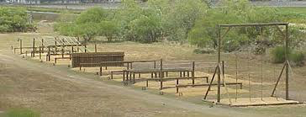
Game:
Disability Obstacle Course

Slide 29
The Patrol Leaders’ Council (PLC)
What is the PLC?
Who are members of the PLC?
How often does it meet and what does it do?
How are the meetings run?
How does the troop find out what was discussed at PLC meetings?

Slide 30

Game:
Helium Stick

Slide 31
Leadership Principles
Just as adult leaders must step back and enable Scout leaders to lead the troop, senior youth leaders must work with, train, and encourage others in the troop to fulfill their roles and practice their own leadership skills.
Let’s define leadership…

Slide 32
Leadership Tips
Keep your word. Don't make promises you can't keep.
Be fair to all. A good leader shows no favorites. Don't allow friendships to keep you from being fair to all members of your troop or patrol.
Be a good communicator. You don't need a commanding voice to be a good leader, but you must be willing to step out front with an effective "Let's go." A good leader knows how to get and give information so that everyone understands what's happening.
Be willing to accept ideas from other people. It encourages other youth leaders to offer suggestions and ideas you may not have thought of.
Be flexible. Not everything goes as planned. Be prepared to shift to "Plan B" when "Plan A" doesn't work. Think about "Plan C.”
Be organized. The time you spend planning will be repaid many times over.

Slide 33
Leadership Tips
Delegate. Some leaders assume that the task will not get done unless they do it themselves. Most people like to be challenged with a task. Empower your team members to do things they have never tried.
Follow up. When people are given assignments, follow up at appropriate times to make sure they haven’t forgotten what they are supposed to do and when.
Set an example. The most important thing you can do is lead by example. Whatever you do, your troop members are likely to do the same. A cheerful attitude can keep everyone's spirits up.
Be consistent. Nothing is more confusing than a leader who acts one way one moment and another way a short time later. If your troop knows what to expect from you, they will more likely respond positively to your leadership.
Give praise. The best way to get credit is to give it away. Often a "nice job" is all the praise necessary to make a Scout feel he is contributing to the efforts of the troop.

Slide 34
Leadership Tips
Ask for help. Don't be embarrassed to ask for help. You have many resources at your disposal. When confronted with a situation you don't know how to handle, ask someone with more experience for some advice and direction.
Criticize in Private. There will be times when you must provide a Scout with critical feedback. Pull the Scout aside and quietly explain what could be done better. Add suggestion on how it should be done correctly.
Accept Criticism as a Gift. Criticism, when offered and received properly, can give you ideas for performing your role better. Being open to suggestions and adopting those that will benefit your troop are signs of a good leader.
Have Fun. Most of all, have fun learning to be a leader. Your joy and enthusiasm will spread to other Scouts and will help energize the activities of the troop.

Slide 35

Game:
Willow in the Wind

Slide 36
Servant Leadership
Choosing to Lead
Give rather than receive
Make a difference
Help others to succeed
Make the group successful
Respect for others…dignity
Focusing on your fellow Scouts development and helping your Patrol and Troop succeed.

Slide 37
Other Leadership Styles
Doing It All Yourself
Controlling
Intimidation
Wanting Everyone to Like You

Slide 38
Module 2
Tools of Leadership

Slide 39
Module 2 Overview
Communications
Planning
The Teaching EDGE

Slide 40
Communications
Three parts:
  Sender / Message / Receiver
Applies to all forms:
  Verbal / Written / Music / Signal / Etc.
Receiving (Listening) – Understand the value of being a good listener. It is fundamental to being a good leader.

Slide 41

Game:
Telephone Game

Slide 42

Game:
Night Crossing

Slide 43
Planning
Second only to communicating, good planning is an essential skill for effective leadership. (Events don’t “just happen,” but must be carefully planned.)
Better planning leads to more fun and greater success
At its core…thinking ahead!

Slide 44
Planning Videos
Troop Meeting Agenda
  http://troopleader.org/troop-meetings/
PLC
  http://troopleader.org/patrolleaders-council/
Program Features
  https://troopleader.org/program-features/
Pass out copies of the Troop Meeting Agenda Planning Sheet

Slide 45
Planning Quotes
“A goal without a plan is just a wish.”
“You don’t have a plan until you have made a backup plan.”
“In preparing for battle I have always found that plans are useless, but planning is indispensable.”
~Dwight D. Eisenhower
“By failing to prepare, you are preparing to fail.”
“Failure to plan is planning to fail.”
“No plan survives contact with the enemy.”
“A plan is something to deviate from.”
“A good plan violently executed now is better than a perfect plan executed next week.”
“Every good plan is a previous plan’s backup plan.”
“A plan is a list of things that aren’t going to happen.”

Slide 46
Teaching EDGE
The four-step EDGE process is a simple method for teaching any skill:
  Explain — The trainer explains how something is done.
  Demonstrate — After the trainer explains, the trainer demonstrates while explaining again. This gives the learner a clear understanding of what success looks like.
  Guide — The learner tries the skill while the trainer guides him through it. The trainer gives instant feedback as the learner practices the skill.
  Enable — The learner works independently under the watchful eye of the trainer. The trainer helps remove any obstacles to success, thus enabling the learner to succeed.

Slide 47
Teaching EDGE
Let’s see it in action…

Slide 48
Module 3
Leadership and Teamwork

Slide 49
Module 3 Overview
Introduction to Leadership & Teamwork Session
Teams & Team Characteristics
  Stages of Team Development
  Including the Whole Team
  Revisiting Vision
  Leadership Ethics & Values
  Role Playing Leadership Challenge Scenarios

Slide 50

Game:
Integrity Game (part 1)

Slide 51
Team
A team is any group working towards a common goal.
Just because we call something a “team” does not mean that the group functions effectively.

Slide 52
Team Characteristics
Common Purpose
  Goal must be clear
  Personal goals linked to team goals
Interdependence – all members must be successful in individual roles
Roles, Structure, and Process
  People know their roles and boundaries
  Decisions are agreed upon and supported – Feedback is timely and useful
  Communications channels are open
Leadership and Competence
  Members have necessary skills to accomplish their tasks
  Team has the leadership and support it needs to succeed
Team Climate is respectful, trusting, and collaborative
Performance Standards are high and continuously monitored/improved
Clarity and Understanding of Boundaries

Slide 53
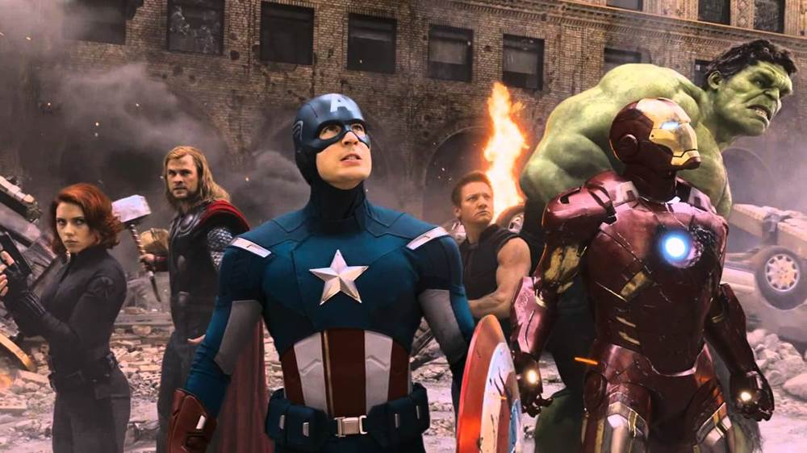
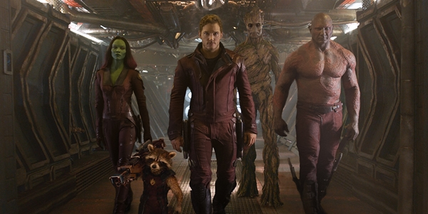
Team & Team Characteristics

Slide 54
Team Skill Level & Enthusiasm
Skill Level
  Generally starts low and increases as team grows together and gets better at working as a team
Enthusiasm
  Generally starts out high but can take a sudden dip
  As team members explore their differences and align their expectations with reality
  Team begins to achieve results and enthusiasm begins to rise again
Forming Starting Out Enthusiasm High Skills Low
Storming Becoming Discouraged Enthusiasm Low Skills Low
Norming Making Progress Enthusiasm Increasing Skills Increasing
Performing Finding Success Enthusiasm High Skills High

Slide 55
Leading EDGE in Leadership
The Leading EDGE enables a leader to help team members learn and grow as they strive toward a goal.
Explaining
Demonstrating
Guiding
Enabling
Forming Starting Out Enthusiasm High Skills Low
Storming Becoming Discouraged Enthusiasm Low Skills Low
Norming Making Progress Enthusiasm Increasing Skills Increasing
Performing Finding Success Enthusiasm High Skills High

Slide 56
Including the Whole Team
Leaders want to look at their team and see how best to involve and use the skills of every person, not just a few friends or the strongest individuals.
Leaders also want to understand the needs and goals of each individual person and how all the members of the team can help each team member achieve their individual goals.

Slide 57

Game:
The Rock Game

Slide 58
Vision (Revisited)
We previously discussed the concept of a vision, but let’s apply it to what we’ve been learning…
  How will each of you use the skills you’ve learned to make the vision for the Troop a reality?
Before the next troop meeting…
  Prepare a vision for your position.
  Identify what goals (steps) you will use to achieve your vision.

Slide 59
Leadership Ethics & Values
On my honor…as a leader…
I will do my best…as a leader…
To do my duty…as a leader...
To God and my country…as a leader...
And to obey the Scout Law...as a leader...
To help other people at all times...as a leader...
To keep myself physically strong...as a leader...
Mentally awake...as a leader...
And morally straight....as a leader...

Slide 60
Role Playing
Common scenarios that present leadership challenges…

Slide 61
Game:
Integrity Game (part 2)

Slide 62

You are now officially trained in your leadership position.
For you as a leader, now the hard stuff starts…
Be a Great One!

Slide 63
EXTRA SLIDES

Slide 64
Where the Troop Is…
What should we start doing that we are not currently doing?
What do we need to stop doing?
What should we continue doing that is working well and helps us succeed?

Slide 65
The Servant Leader
Boss vs Team Member
When a leader recognizes that he is responsible to the team (and not the other way around) and acts accordingly, he becomes a “servant leader.”
Enable the success of those led, remove barriers for them to the best of the leader’s ability, and create an environment for the team to succeed.
Leaders need to lead— to set direction and lead team members in that direction.

Slide 66
The Servant Leader (cont’d)
Need to listen and know when the time for discussion is over.
Achieve consensus and know when to preserve things that are good without foundering in a constant storm of question and reinvention.
Set/maintain standards and know when to reject what does not maintain those standards or the team vision.
Serve their customers and know how to make a difference with the team. Please think about how you can be a servant leader in your current role in the troop.

